Slide 1
Preparation For Data Science
Maths Interview Questions

Slide 2
Ques 1) Explain Central Limit Theorem?
Ans) The theorem states that as the size of the sample increases, the distribution of the mean across multiple samples will approximate a Gaussian distribution (Normal).
Generally, sample sizes equal to or greater than 30 are considered sufficient for the CLT to hold. The average of the sample means will be equal to the population mean. This is the key aspect of the theorem.
Assumptions :
The data must follow the randomization condition.
Samples should be independent of each other.
Sample size should be no more than 10% of the population when sampling is done without replacement

Slide 3
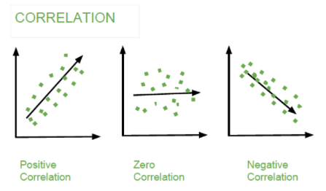
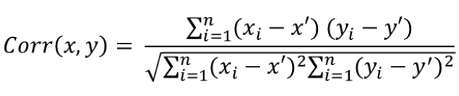
Ques 2) Explain Correlation?
Ans) Correlation show whether and how strongly pairs of variables are related to each other. Correlation takes values between -1 to +1, wherein values close to +1 represents strong positive correlation and values close to -1 represents strong negative correlation.

Slide 4
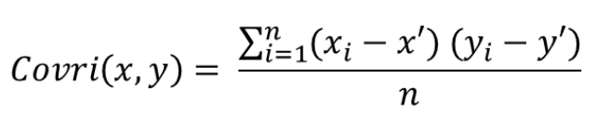
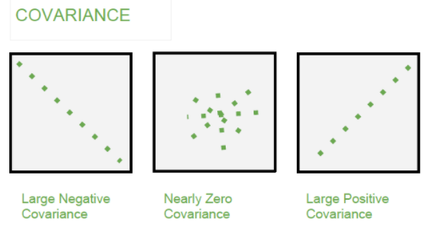
Ques 3) Explain Covariance?
Ans) Covariance is the relationship between a pair of random variables where change in one variable causes change in another variable.
It can take any value between -infinity to +infinity, where the negative value represents the negative relationship whereas positive value represents the positive relationship.

Slide 5

Ques 4) What is Pearson Correlation ?
Ans) Pearson correlation is used as a measure for quantifying linear dependence between two continuous variables X and Y. Its value varies from -1 to +1.
Ques 5) Explain F Test, T Test and Z test?
Ans) F Test- The F-test is designed to test if the two population variances are equal. It compares the ratio of the two variances. Therefore, if the variances are equal, then the ratio of the variances will be 1.
T Test- T-test used to compare the mean of the given samples. It assumed a normal distribution of the samples. A t-test is used when the population parameters (mean and standard deviation) are unknown.
Z Test- It is used to determine whether the means are different when the population variance is known and the sample size is large (greater than 30). It assumes population distribution is normal. Samples are random & independent.

Slide 6
Ques 6) Explain LDA, ANOVA and Chi-Square?
Ans) LDA- Linear discriminant analysis is used to find a linear combination of features that characterizes or separates two or more classes (or levels) of a categorical variable.
ANOVA- ANOVA stands for Analysis of variance. It provides a statistical test of whether the means of several groups are equal or not.
It assumes- a)population distribution normal b)samples are random & independent
Chi-Square- It is a is a statistical test applied to the groups of categorical features to evaluate the likelihood of correlation or association between them using their frequency distribution.
Ques 7) Explain Null Hypothesis.
Ans) A statement which states that there is no relationship between the variables. It is exact opposite of what an investigator predicts or expect.

Slide 7
Ques 8) Explain Alternate Hypothesis?
Ans) A statement which states there is relationship between the variables. It is exactly what an investigator predicts or expect. Statistical tests are not performed on it.
Ques 9) Explain Level of Significance(𝛂)?
Ans) It is probability of rejecting null hypothesis when it is true (Also called Type 1 error). It can be set at 5% or lower.
Lower Significance level indicates that stronger evidence is required before rejecting null hypothesis.
Ques 10) Explain Critical Value?
Ans) Critical value is the cutoff value which is to be compared with the test value to take a decision about the null hypothesis. It divides the graph into two sections- Rejection area and Acceptance area.
If the value of test statistics is greater than the critical value - Reject the Null hypothesis. If test statistics value less than critical value - Fail to reject Null.

Slide 8
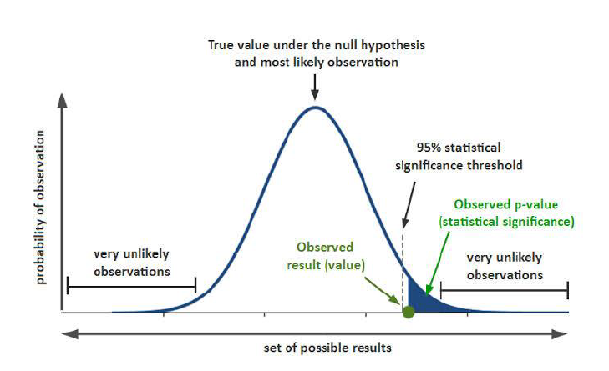
Ques 11) Explain P Value ?
Ans) P value (or probability value) is the probability of obtaining test results at least as extreme as the results actually observed, under the assumption that the null hypothesis is true.
The lower the p value, the stronger the evidence that the null hypothesis is false (the null hypothesis is rejected when p value is 0.05 or lower).

Slide 9
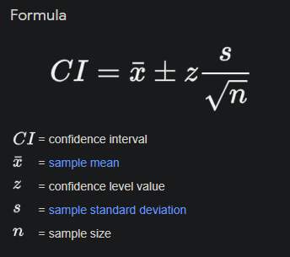
Ques 12) Explain Confidence Interval.
Ans) A confidence interval displays the probability that a parameter will fall between a pair of values around the mean. Confidence intervals measure the degree of uncertainty or certainty in a sampling method.
95% confidence interval (𝛼 = 0.05) are most common.

Slide 10
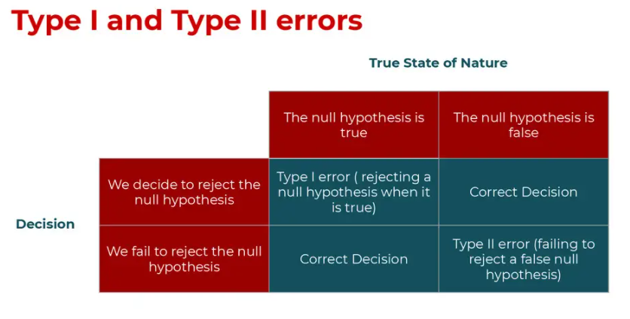
Ques 13) Explain Type 1 and Type 2 error.
Ans) Type 1 Error -
A Type 1 Error is mistake of rejecting the null hypothesis when it is true. Denoted by 𝝰.
Type 2 Error -
A Type 2 error is mistake of failing to reject the null hypothesis when it is false. Denoted by 𝛃.
Notes:
Add more questions

Slide 11
Ques 14) What is the difference between inferential statistics and descriptive statistics?
Ans)
Significance Level - The Significance Level (denoted by ɑ ) defines how much evidence we required to reject ho in favour of ha.
Critical Region - Critical region (or Rejection region) is the set of all values of the test statistic that cause us to reject the null hypothesis.
Notes:
Add more questions

